Slide 1






INFORMATION MEETING
Class of 2027

Slide 2






SATS
WHEN
WHAT
WHY
Standard Assessment Tests are mandatory academic tests taken by primary school children in England in May of their Year 6. They test Maths, Grammar Punctuation and Spelling and Reading.
Official Tests:
Monday 10th May to Thursday 13th May 2027.
Mock SATs:
November 2026
February 2027
Results measure student progress, evaluate overall school performance and help secondary schools understand incoming pupils.

Slide 3

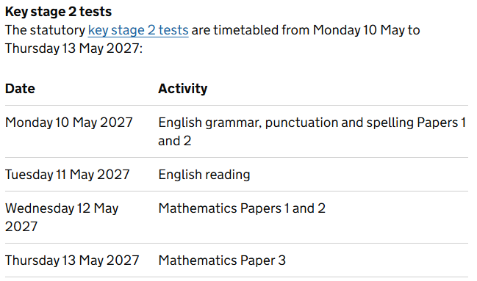


Slide 4
WHAT IS BEING ASSESSED IN MATHS?
• Number and place value, approximation and estimation/rounding
• Four rules of calculation
• Fractions, decimals and percentages
• Ratio and proportion
• Algebra
• Measurement
• Geometry: properties of shape
• Geometry: position and direction
• Statistics

Slide 5
TYPES OF QUESTIONS IN MATHS
The arithmetic test (Paper 1) will check that the children can select the most efficient method in order to complete calculations quickly.
All of the questions in the reasoning papers (Paper 2 and 3) will have a context (word problems) and can be read to the child if they request this.

Slide 6
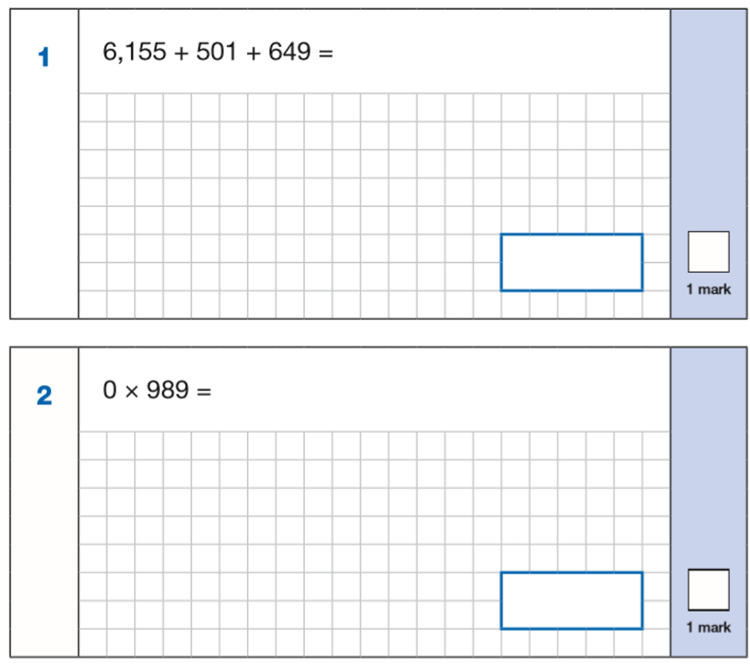
KS2 ARITHMETIC TEST
ALL QUESTIONS HAVE A GRID EVEN WHEN THE CHILDREN MAY NOT NEED IT.

Slide 7
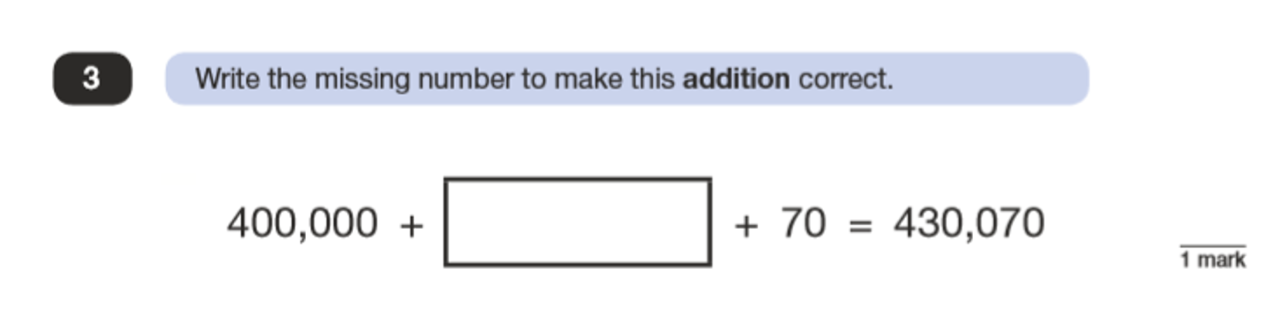
KS2 REASONING PAPERS
These involve applying their arithmetic knowledge to maths problems.

Slide 8
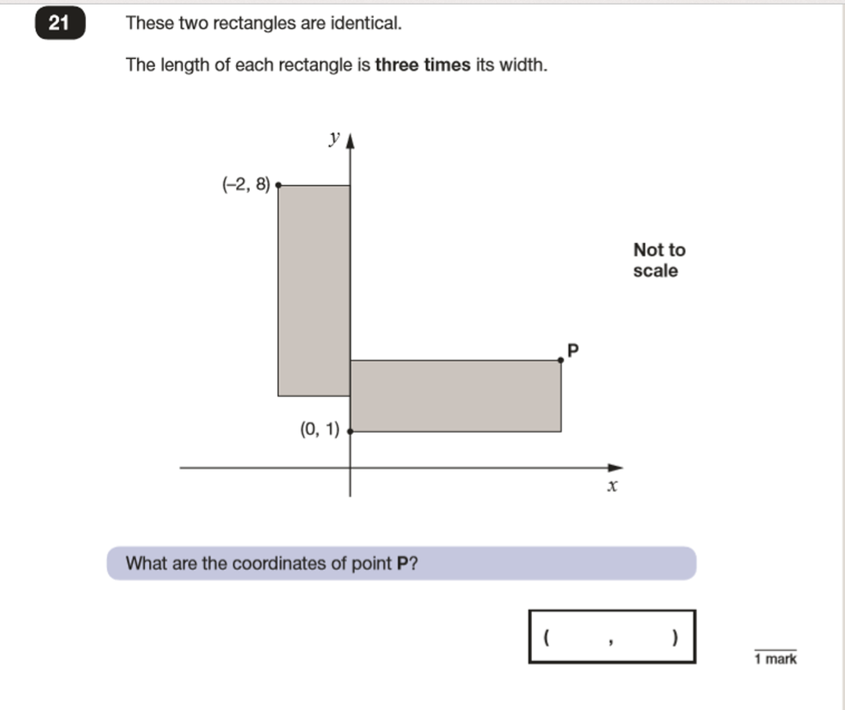
KS2 REASONING PAPERS
These involve applying their arithmetic knowledge to maths problems.

Slide 9

READING PAPER
60 minutes
50 marks
3 texts to read

Slide 10

READING PAPER QUESTIONS
•Multiple choice
•Ordering
•Find and copy
•Give evidence
•Explain
•Predict
•Fact/opinion
•True/false
•Inference

Slide 11
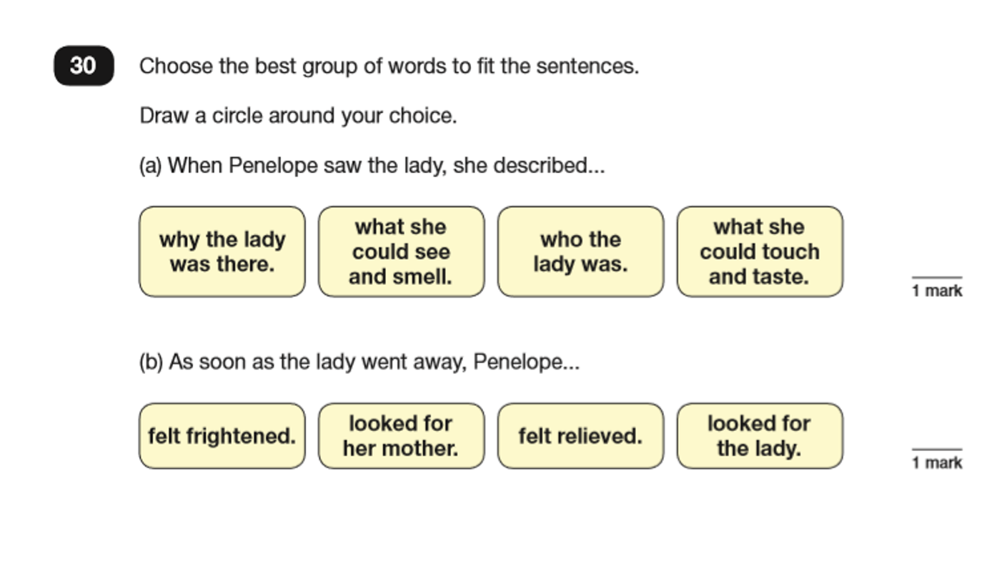
READING PAPER QUESTIONS

Slide 12
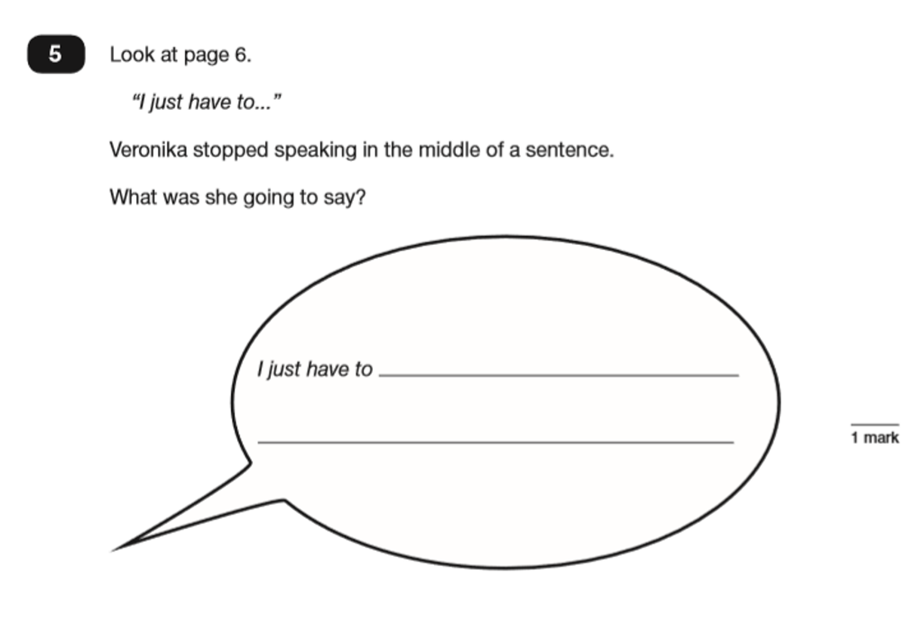
READING PAPER QUESTIONS

Slide 13
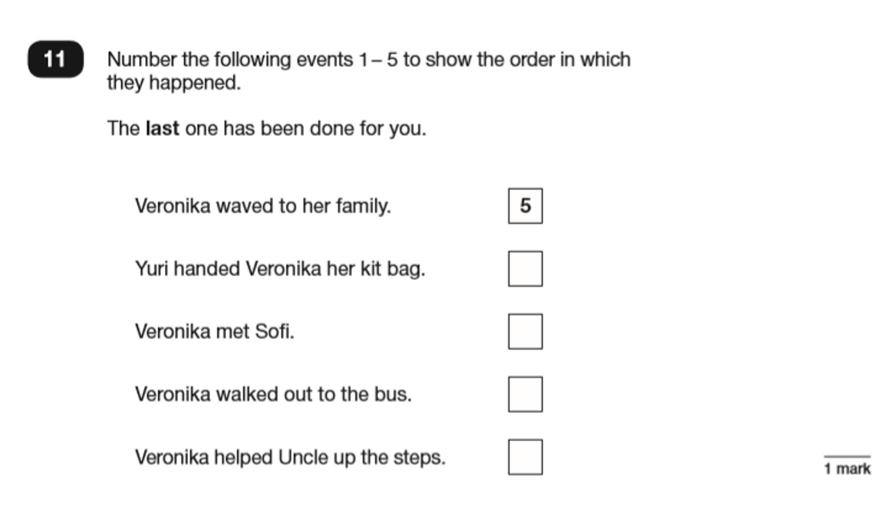
READING PAPER QUESTIONS

Slide 14
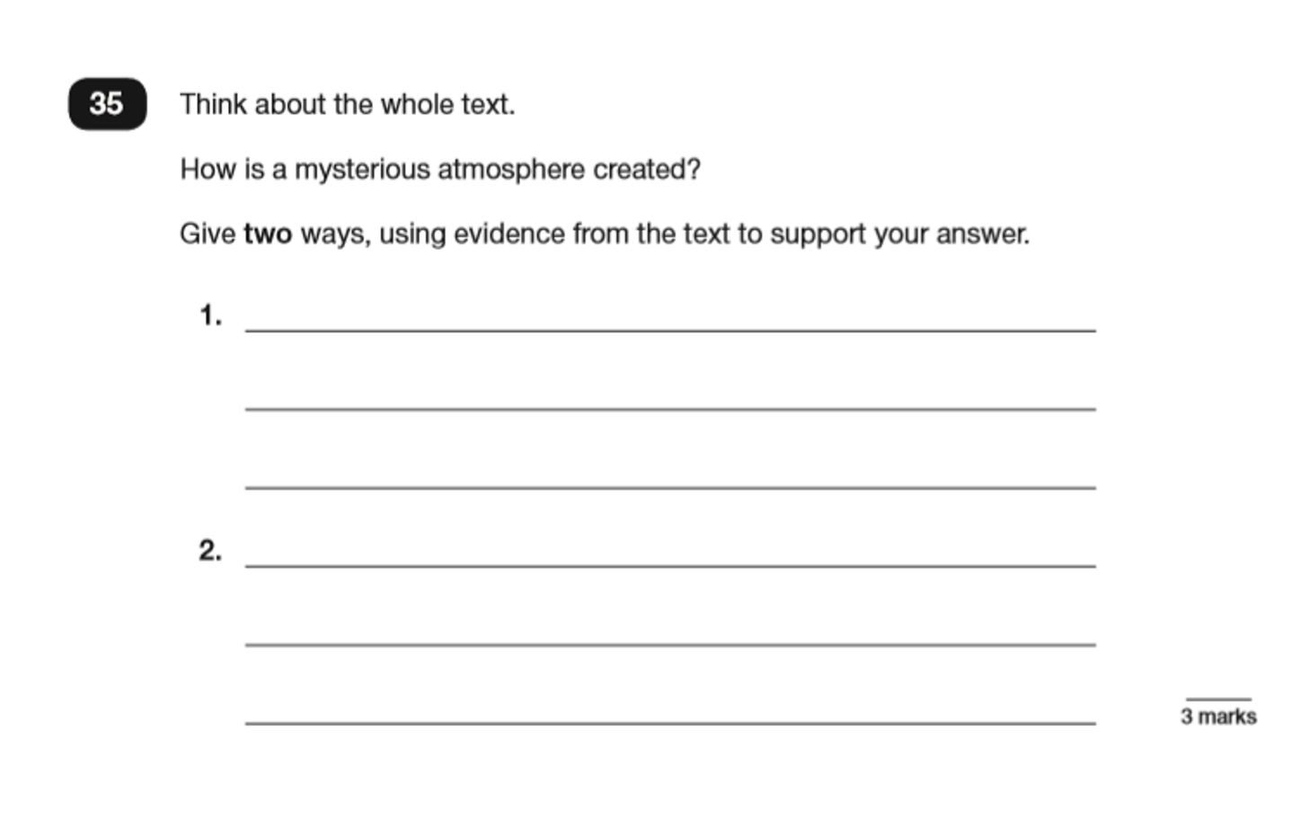
READING PAPER QUESTIONS

Slide 15
SPELLING, GRAMMAR AND PUNCTUATION
The SPaG test comprises of 2 tests.
•Paper 1: Grammar and punctuation short answer questions - 45 minutes with a maximum of 50 marks.
•Paper 2 - spelling test - 15 minutes long with a maximum of 20 marks.

Slide 16
SPELLING, GRAMMAR AND PUNCTUATION
• Grammatical terms/word classes
• Function of sentences
• Combining words, phrases and clauses
• Verb form, tense and consistency
• Punctuation
• Vocabulary
• Standard English and formality

Slide 17
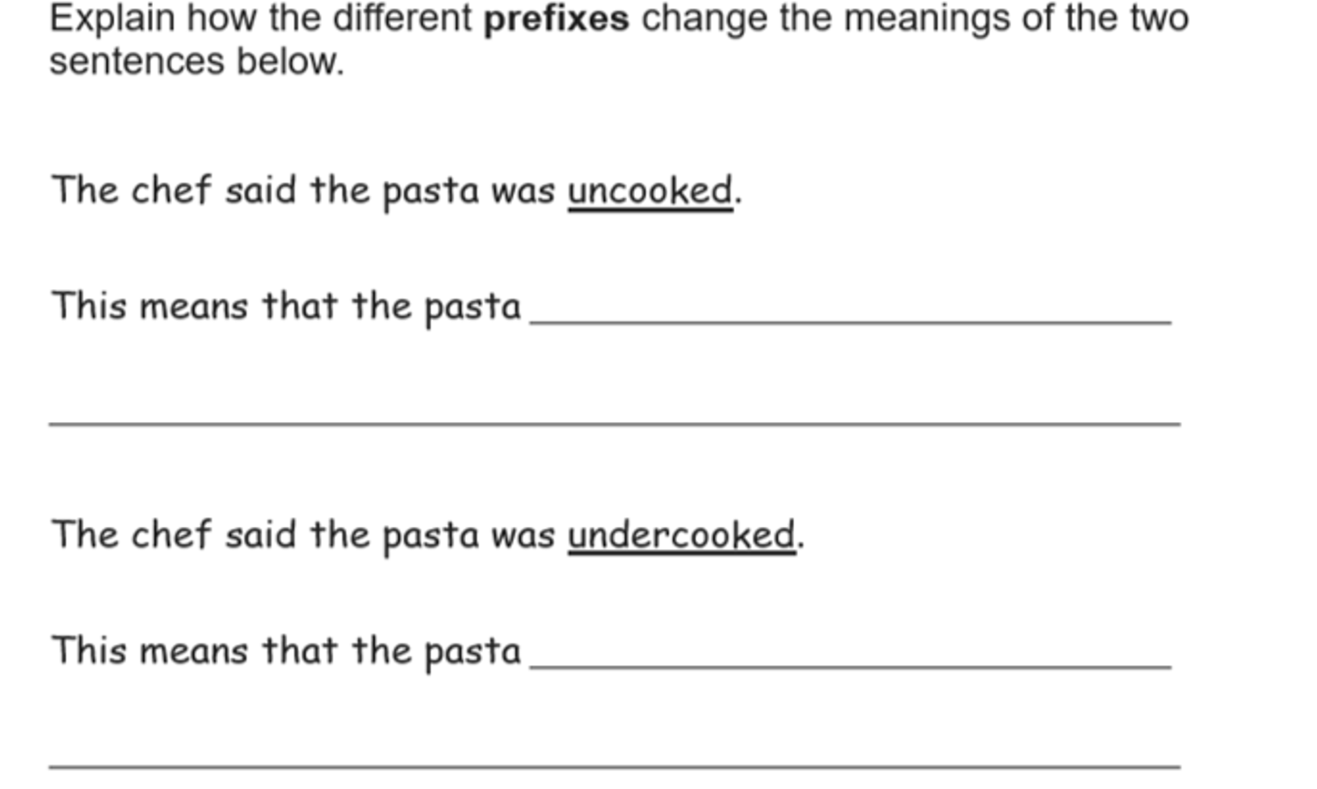
SPELLING, GRAMMAR AND PUNCTUATION

Slide 18
SPELLING
The main trick for success is to start speaking in a ‘spelling voice’.
By doing this, children can hear the letters:
‘government’ ‘dustbin’ ‘different’
Breaking up the word into sounds and syllables can also help with spelling:
choc/o/late
Feb/ru/ary

Slide 19
WRITING
There is no formal test for writing.
The children's writing is assessed throughout their time in Year 6.
There is a moderation process for writing.

Slide 20


SATS WEEK
01
Breakfast
02
Mornings
We will be inviting children into school early for a free breakfast. (Mon - Thurs)
This will enable them to energise themselves beforehand and also gives them time to ask any last minute questions.
The tests will take place in the mornings, before break.
Most children will be a classroom with their class teacher.
After the test has finished, they will have a break and a less formal rest of the morning.
03
Afternoons
Afternoons will be used for both continuing to prepare for the next day and taking part in some outdoor activities and PE.

Slide 21
WHAT WE ARE DOING:
01
02
Mock SATs
Homework
Allows children to practise taking the tests, under test conditions, so they are second nature in May.
Allows teachers to see what our children need us to go back over.
Weekly homework is being handed out to give opportunities to practise.
Homework is being marked every week to allow us to feedback and further support the children.
03
04
Maths Sets
Revision sessions
We will regularly review our classes to make sure we can offer the best support to all of the children.
As we get closer to the SATs, we will be inviting children to revision sessions after school as well as using some time in school to go over previous learning.

Slide 22
WHAT YOU CAN DO:
01
02
Homework
Attendance
Ensure your child is completing their homework, including reading, each week.
This is also excellent practice for secondary school.
Ensure your child is at school every day that they possibly can be.
We cannot teach them or support them if they are not in school.
03
04
Seriously Awesome Tests
Contact the school
Let us know if you or your child have any questions or concerns.
We are here to help.
Contact the office and one of us will be in touch.
Remind your child that all we can ask for is their best and that we will all be proud of that.
We will be doing everything we can to make sure they are ready.

Slide 23
RESULTS
Results will be shared with you in the children’s end of year reports in July.

Slide 24

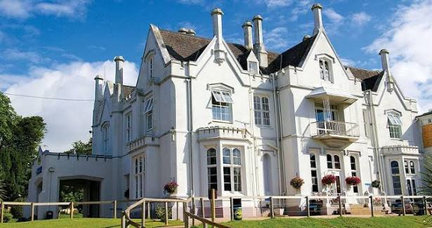
RESIDENTIAL
WHEN
WHERE
WHO
Monday 21st - Wednesday 23rd June 2027
Barton Hall PGL - Torquay
Year 6
Miss Stewart
Mrs Dunn
Mr Rogers
Mrs Roberts
Mrs Tantrum/Mr David
Our friends at Beechcroft

Slide 25

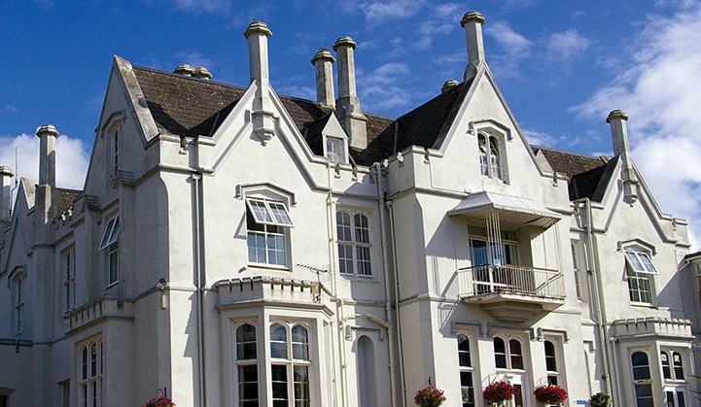
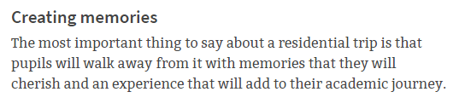
Barton Hall Monday 21st June – Wednesday 23rd June 2026
South Devon

Slide 26
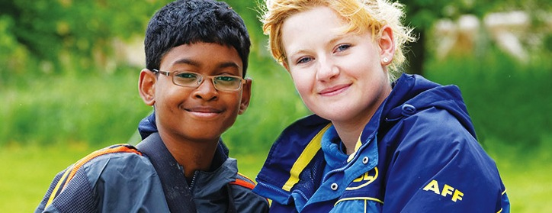




Welcome to PGL
The UK’s largest provider of outdoor education for young people
Over 55 years’ experience
Fully risk assessed
LOtC Quality Badge holder
Founding member of BAPA
ABTA bonded
Notes:
PGL provides a wide range of inspiring residential adventure and educational courses for more than 5,000 groups every year
All PGL centres and activities are risk assessed to comply with legal requirements and best practice. Risk assessments are available by request and on the PGL website
Centres are subject to the Adventure Activities Licensing Authority regulations (AALA) where appropriate
ABTA (Association of British Travel Agents) bonded means your money is protected
BAPA – British Activity Providers Association. Responsible for establishing operating guidelines for the activity holiday industry
Through the Learning Outside the Classroom Quality Badge Programme you can be confident that recognised providers fulfil all the necessary criteria as laid down by the DfE, thereby better enabling Party Leaders to manage visits safely, efficiently and beneficially

Slide 27
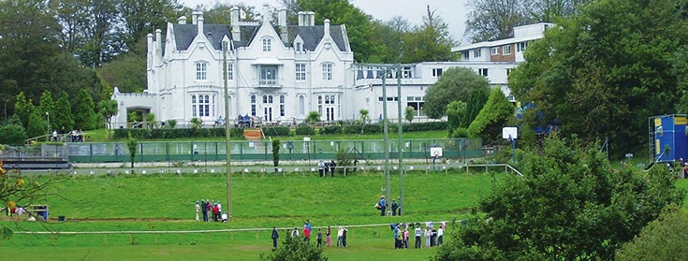
LEARNING OUTSIDE
Barton Hall – South Devon
29 fantastic adventure activities to choose from
Beautiful location with blue flag beaches nearby
Heated outdoor pool and lakes for watersports

Slide 28

The PGL difference
Dedicated PGL Tour Leader to provide support throughout stay
Tailored excursion programme to cultural places of interest
Free on-site adventure activities
Evening entertainment programme
24 hour support from centre team
Notes:
Your PGL Tour Leader will have a wealth of local knowledge so you can make the most of your time away.

Slide 29
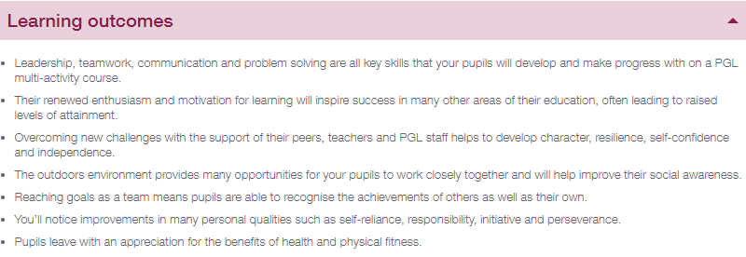
The PGL difference
Notes:
Your PGL Tour Leader will have a wealth of local knowledge so you can make the most of your time away.

Slide 30
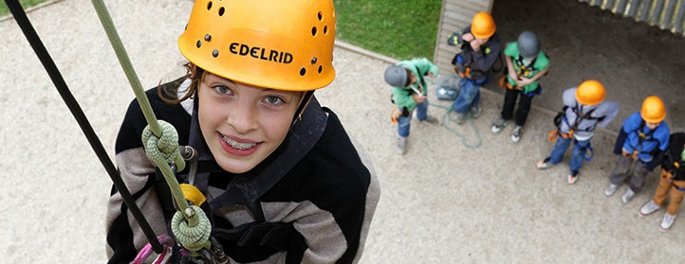
Adventure activities
Abseiling
Aeroball
Aquafun
Archery
Canoeing
Challenge Course
Climbing
Crate Challenge
Dry Slope Skiing
Fencing
First Aid
Giant Swing
Hiking
Jacob’s Ladder
Low Level Ropes
Course
Mountain Biking
Nature Trail
Orienteering
Problem Solving
Quad Biking
Raft Building
Sensory Trail
Sports and Team Games
Survivor
Trapeze
Vertical Challenge
Zip Wire
Notes:
The activities shown offer individual as well as team challenges
Activities are designed to encourage new skills and develop existing ones
Specific activities can be requested (though not guaranteed) and the programme is discussed on arrival at the centre

Slide 31
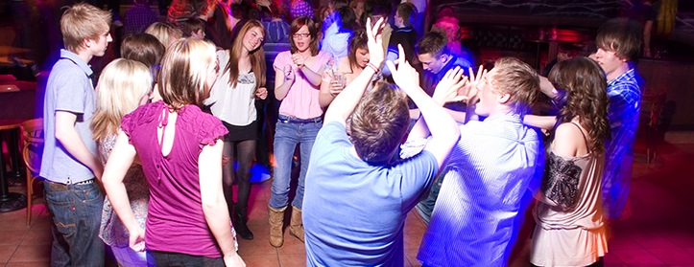
Evening entertainment
Ambush
Campfire
Capture the Flag
Cluedo
Disco
Passport to the World
Snapshot
Splash
Starburst
Team Challenge

Slide 32
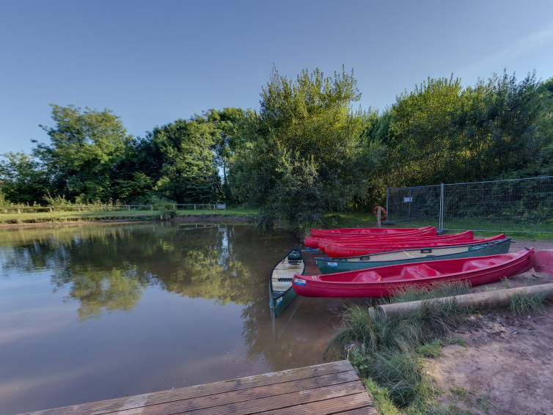

Slide 33
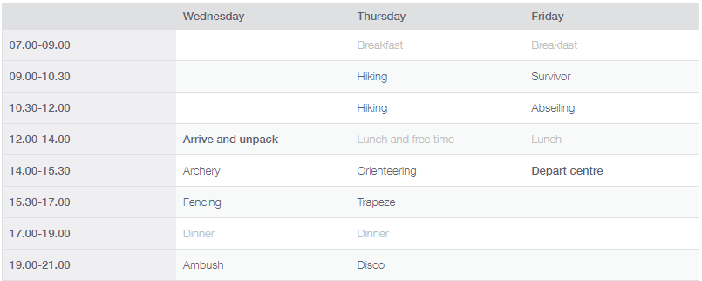
SAMPLE ITINERARY

Slide 34
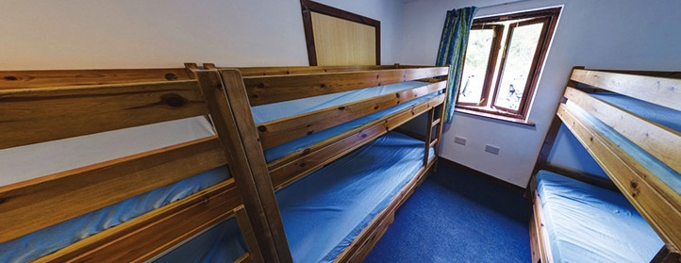
Accommodation
Main House – en suite rooms sleep 4-10
Chalets – en suite rooms sleep 4-6
Teaching Staff have rooms next door to the children’s rooms.
Children will be asked nearer the time who they would like to share a room with.
Notes:
The centre can accommodate 700 guests at a time with accommodation in the main house or purpose-built chalets
Teachers are usually accommodated in twin rooms with en suite and hot drink facilities
All rooms are lockable (party leader given master key)
All exterior doors and gates are locked at night but can be opened from the inside in an emergency without the need for unlocking
A PGL staff member is available on duty throughout the night (contactable by phone)
The extensive facilities (other than activity bases) are available to your group during free time

Slide 35
Accommodation
Teaching Staff will make sure that all medication is looked after and that children take it when needed.
Notes:
The centre can accommodate 700 guests at a time with accommodation in the main house or purpose-built chalets
Teachers are usually accommodated in twin rooms with en suite and hot drink facilities
All rooms are lockable (party leader given master key)
All exterior doors and gates are locked at night but can be opened from the inside in an emergency without the need for unlocking
A PGL staff member is available on duty throughout the night (contactable by phone)
The extensive facilities (other than activity bases) are available to your group during free time

Slide 36
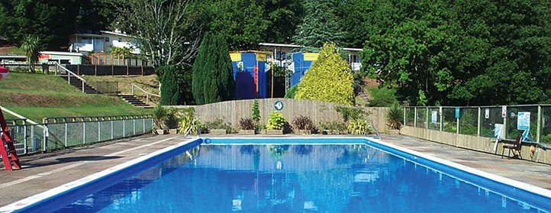
Facilities
Outdoor heated swimming pool
Indoor Activity Zone
Lakes for watersports
On-site adventure activities
Disco
Shop
Classrooms / meeting rooms

Slide 37
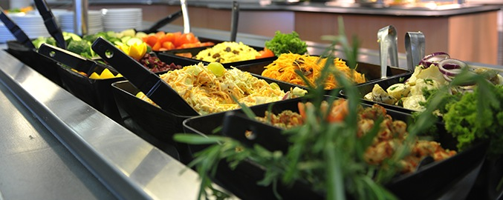
Catering and dietary needs
3 nutritious, balanced meals per day
Self-service salad bar
Vegetarian option
Special diets catered for by prior arrangement
Sample menus available online: www.pgl.co.uk
Notes:
We continually invest in healthy menus with freshly cooked ingredients obtained from fully traceable audited suppliers
Processed food is avoided and meals meet Local Authority guidelines
There will be hot and cold options available at every meal
At lunch and dinner the buffet includes a salad bar and mixed fruit basket plus hot and cold drinks
Our caterers can deal with most dietary requirements but please ensure the party leader is aware of any dietary requirements well in advance
More food is always available if required

Slide 38
What’s included in the cost?
-Travel
-Full Board Accommodation
All Adventure Activities
All evening entertainment
What’s Not Included?
Children need to bring their own bedding/sleeping bag.
Notes:
Questions?

Slide 39
Cost
Any parents who are not able to send their child due to financial reasons please get in touch with the school as we may be able to help signpost to possible funding options to help.

Slide 40
UPDATE: 15/10/26
We have had notification from the PGL that we are going to that they may not continue to operate due to financial pressures - things are up in the air for them at the moment and they have given us a heads up. As a contingency, they have made us a backup booking at another PGL facility which we will investigate more if/when we need to. We will keep you posted and it is nothing to worry about as we have a guaranteed booking and the price will not increase as a result.

Slide 41
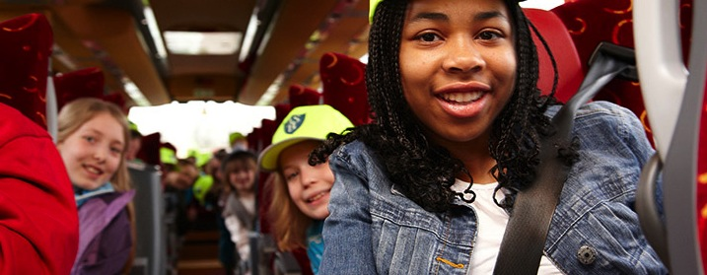
Thank you for listening
Any questions?
Notes:
Questions?

